Slide 1
Concurrency Programming in .NET

Slide 2
Objectives
Overview Concurrency Programming
Overview about MultiThreading
Explain about Synchronization: lock and Monitor
Explain and Demo about The Issue of Concurrency: Race Conditions
Explain about ThreadPool and TimerCallback
Demo MultiThreading application with C#
Demo Synchronization in MultiThreading application
Demo ThreadPool and TimerCallback

Slide 3
Processes and Multi Processing System
A process has a self-contained execution environment
A process generally has a complete, private set of basic run-time resources; in particular, each process has its own memory space
Multi Processing/ Multi Tasking System: System allows many processes executing concurrently
A thread is a path of execution within an executable application
By implementing additional threads, we can build more responsive (but not necessarily faster executing) applications

Slide 4
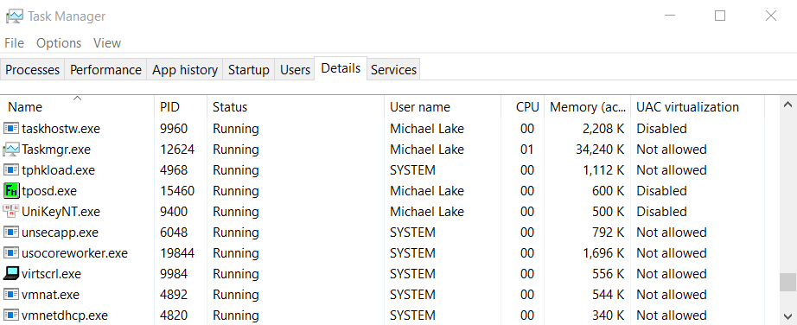
Processes and Multi Processing System

Slide 5
Concurrency in Operating System
Concurrency is the execution of the multiple instruction sequences at the same time. It happens in the operating system when there are several process threads running in parallel
The running process threads always communicate with each other through shared memory or message passing. Concurrency results in sharing of resources result in problems like deadlocks and resources starvation
Concurrency helps in techniques like coordinating execution of processes, memory allocation and execution scheduling for maximizing throughput

Slide 6
Concurrency in Operating System
App1
Code
Data
App | Code Addr | Duration (mili sec) | CPU
App1 | 10320 | 15 | 1
App2 | 40154 | 17 | 2
App3 | 80166 | 22 | 1
… | … | … | …
… | … | … | …
App2
Code
Data
App3
Code
Data
Time-slicing
Mechanism
Memory
A method of allocating CPU time to individual process in a priority schedule

Slide 7
Advantages of Concurrency
Running of multiple applications: It enable to run multiple applications at the same time
Better resource utilization: It enables that the resources that are unused by one application can be used for other applications
Better average response time: Without concurrency, each application has to be run to completion before the next one can be run
Better performance: It enables the better performance by the operating system. When one application uses only the processor and another application uses only the disk drive then the time to run both applications concurrently to completion will be shorter than the time to run each application consecutively

Slide 8
Issues of Concurrency
Non-atomic: Operations that are non-atomic but interruptible by multiple processes can cause problems
Race conditions: A race condition occurs of the outcome depends on which of several processes gets to a point first
Blocking: Processes can block waiting for resources. A process could be blocked for long period of time waiting for input from a terminal. If the process is required to periodically update some data, this would be very undesirable
Starvation: It occurs when a process does not obtain service to progress
Deadlock: It occurs when two processes are blocked and hence neither can proceed to execute
Notes:
Obtain : được , kiếm được, có được

Slide 9
.NET Application Domains
Under the .NET executables are not hosted directly within a Windows process that executables are hosted by a logical partition within a process called an Application Domain
There are several benefits as follows :
AppDomains are a key aspect of the OS-neutral nature of the .NET Core platform, given that this logical division abstracts away the differences in how an underlying OS represents a loaded executable
AppDomains are far less expensive in terms of processing power and memory than
a full-blown process. Thus, the CoreCLR is able to load and unload application
domains much quicker than a formal process and can drastically improve scalability
of server applications

Slide 10
.NET Application Domains
Under the .NET platform, there is not a direct one-to-one correspondence between application domains and threads that a given AppDomain can have numerous threads executing within it at any given time
To programmatically gain access to the AppDomain that is hosting the current thread, using the static Thread.GetDomain() method
A single thread may also be moved into a particular execution context at any given time, and it may be relocated within a new execution context at the whim of the CoreCLR
The CoreCLR is the entity that is in charge of moving threads into (and out of) execution contexts

Slide 11
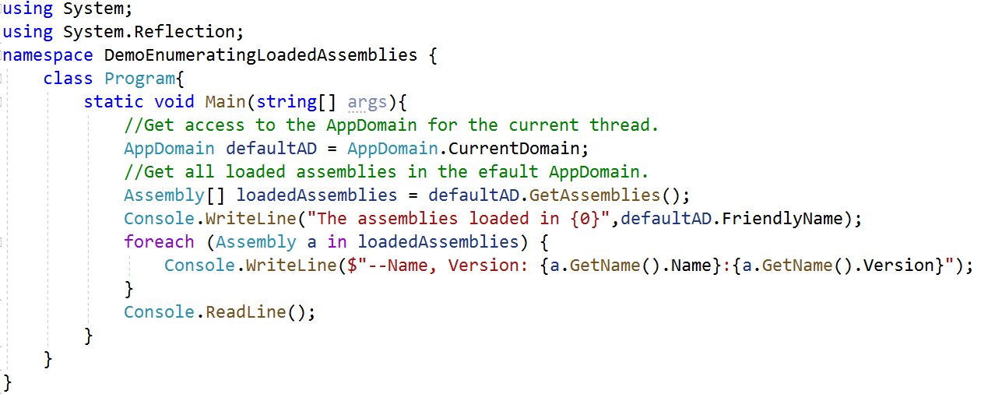
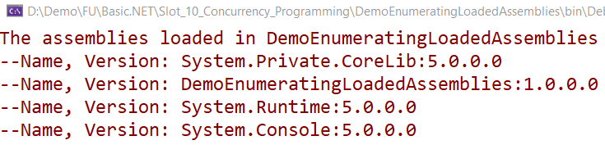
Enumerating Assemblies In AppDomain Demo

Slide 12
Interacting with Processes Using .NET
The System.Diagnostics namespace defines a number of types that allow us to programmatically interact with processes and various diagnostic-related types such as the system event log and performance counters
Process-Centric Types of the System.Diagnostics Namespace | Description
Process | Provides access to local and remote processes and enables you to start and stop local system processes
ProcessModule | Represents a.dll or .exe file that is loaded into a particular process
ProcessModuleCollection | Provides a strongly typed collection of ProcessModule objects
ProcessStartInfo | Specifies a set of values that are used when you start a process
ProcessThread | Represents an operating system process thread
ProcessThreadCollection | Provides a strongly typed collection of ProcessThread objects

Slide 13
Interacting with Processes Using .NET
The System.Diagnostics.Process class allows us to analyze the processes running on a given machine (local or remote) and also provides members to programmatically start and terminate processes, view (or modify) a process’s priority level, and obtain a list of active threads and/or loaded modules within a given process
Properties of the Process Type | Description
ExitTime | Gets the time that the associated process exited
Handle | Gets the native handle of the associated process
Id | Gets the unique identifier for the associated process
MachineName | Gets the name of the computer the associated process is running on
Modules | Gets the modules that have been loaded by the associated process
StartTime | Gets the time that the associated process was started

Slide 14
Interacting with Processes Using .NET
Methods of the Process Type | Description
CloseMainWindow() | Closes a process that has a user interface by sending a close message to its main window
GetCurrentProcess() | Gets a new Process component and associates it with the currently active process
GetProcesses() | Creates a new Process component for each process resource on the local computer
Kill() | Immediately stops the associated process
Start() | Starts (or reuses) the process resource that is specified by the StartInfo property of this Process component and associates it with the component.
More Processes class
https://docs.microsoft.com/en-us/dotnet/api/system.diagnostics.process?view=net-5.0

Slide 15

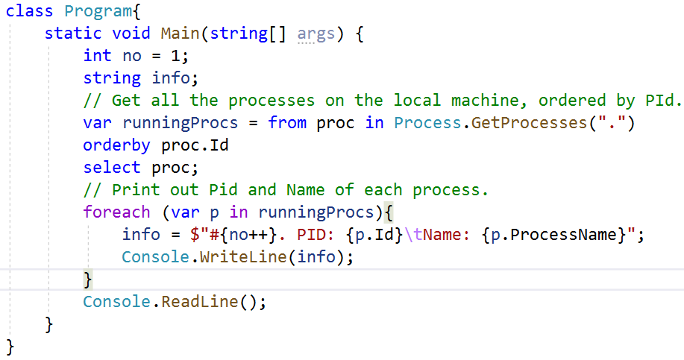
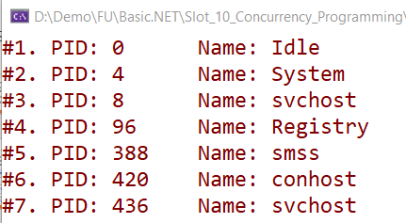
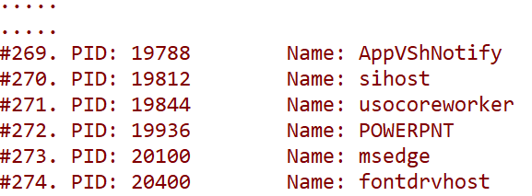
Enumerating Running Processes Demo

Slide 16
System.Threading Namespace
The System.Threading namespace provides a number of types that enable the direct construction of multithreaded applications
It provides types that allow us to interact with a particular CoreCLR thread, this namespace defines types that allow access to the CoreCLR-maintained ThreadPool, a simple (non-GUI-based) Timer class, and numerous types used to provide synchronized access to shared resources

Slide 17
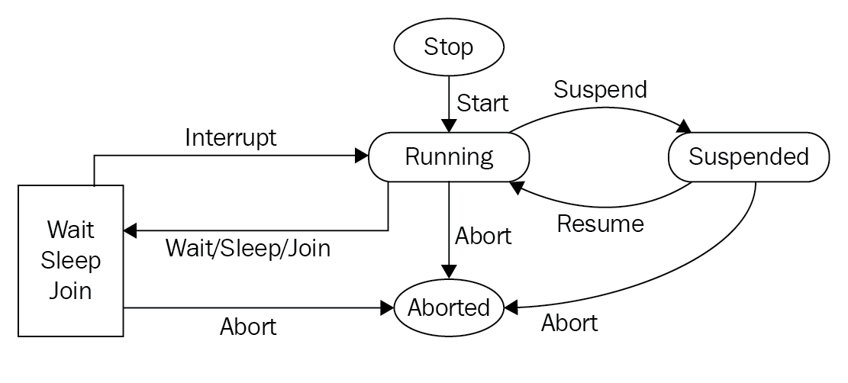
Thread Lifecycle

Slide 18
System.Threading.Thread Class
The most primitive of all types in the System.Threading namespace is Thread
It represents an object-oriented wrapper around a given path of execution within a particular AppDomain
It also defines several methods (both static and instance level) that allow us to create new threads within the current AppDomain, as well as to suspend, stop, and destroy a particular thread

Slide 19
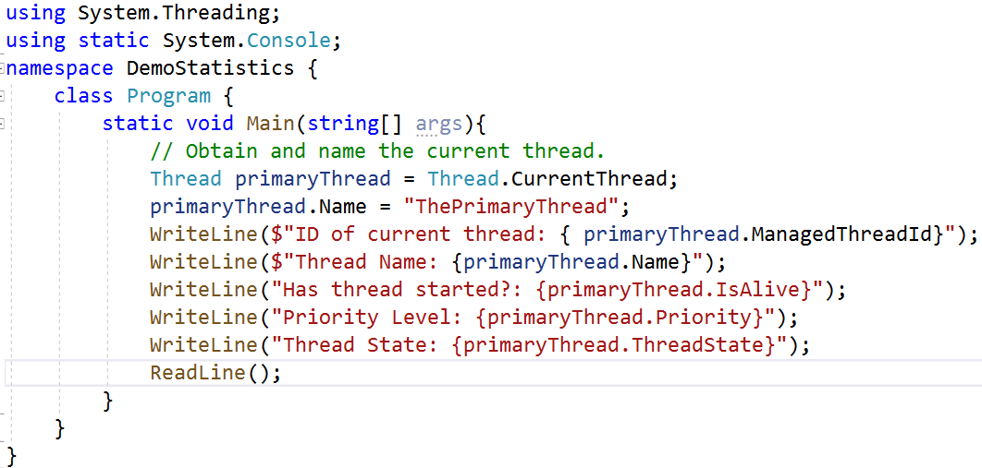
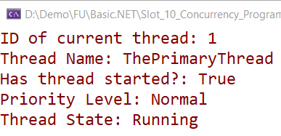
System.Threading.Thread Class

Slide 20
Manually Creating Secondary Threads
Steps to Create a Thread
Create a method to be the entry point for the new thread
Create a new ParameterizedThreadStart (or ThreadStart) delegate, passing the address of the method defined in Step 1 to the constructor
Create a Thread object, passing the ParameterizedThreadStart/ThreadStart delegate as a constructor argument
Establish any initial thread characteristics (name, priority, etc.)
Call the Thread.Start() method. This starts the thread at the method referenced by the delegate created in Step 2 as soon as possible

Slide 21
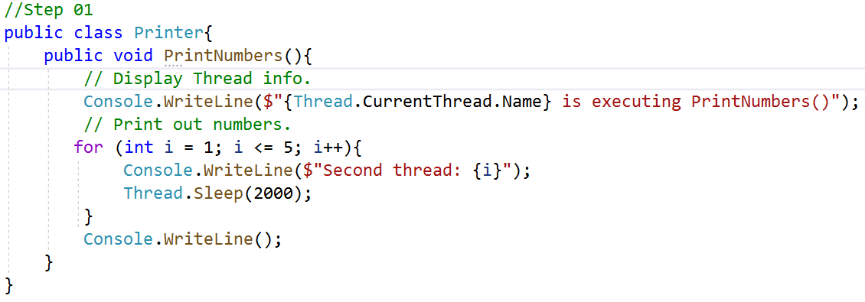
Working with the ThreadStart Delegate

Slide 22
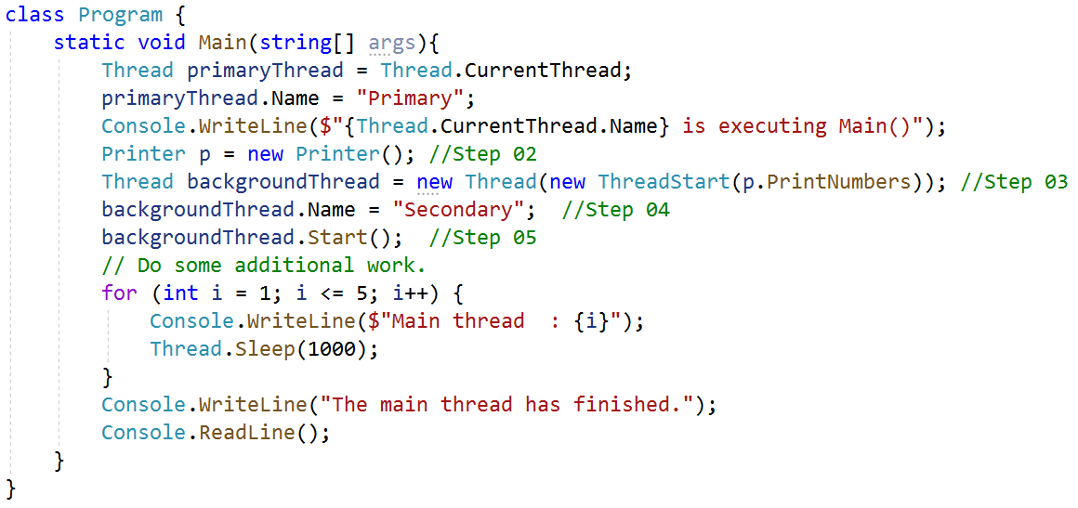
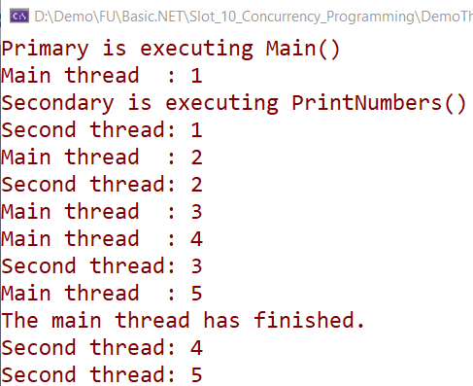
Working with the ThreadStart Delegate

Slide 23
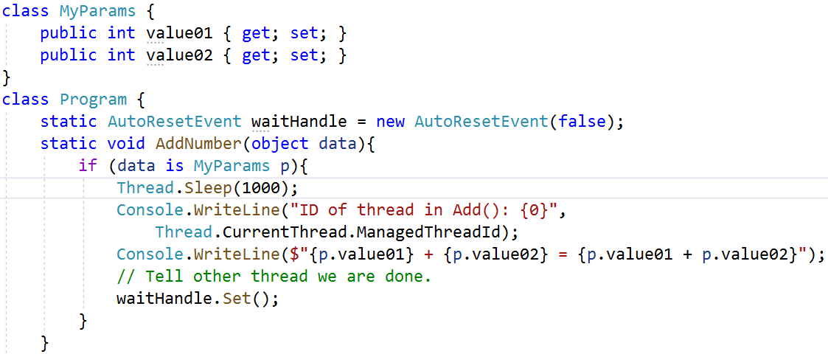
Working with the ParameterizedThreadStart Delegate

Slide 24
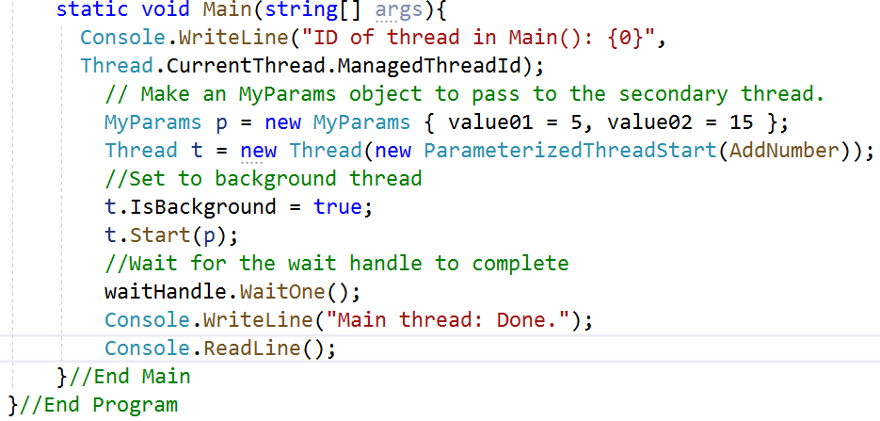
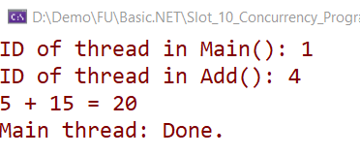
Working with the ParameterizedThreadStart Delegate

Slide 25
Foreground Threads and Background Threads
Foreground threads have the ability to prevent the current application from terminating. The Core CLR will not shut down an application (which is to say, unload the hosting AppDomain) until all foreground threads have ended
Background threads (sometimes called daemon threads) are viewed by the Core CLR as expendable paths of execution that can be ignored at any point in time (even if they are currently laboring over some unit of work)
Thus, if all foreground threads have terminated, any and all background threads are automatically killed when the application domain unloads

Slide 26
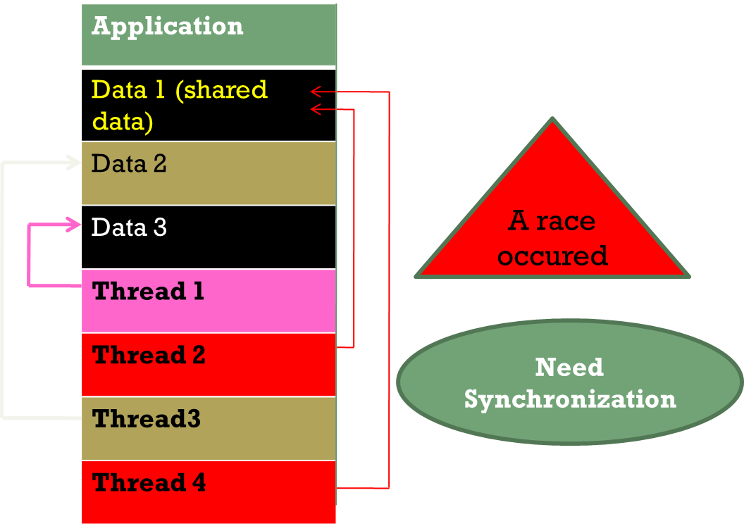
The Issue of Concurrency: Race Conditions

Slide 27
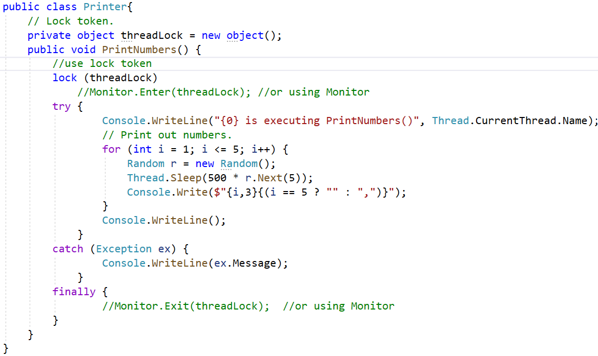
The Issue of Concurrency: Race Conditions

Slide 28
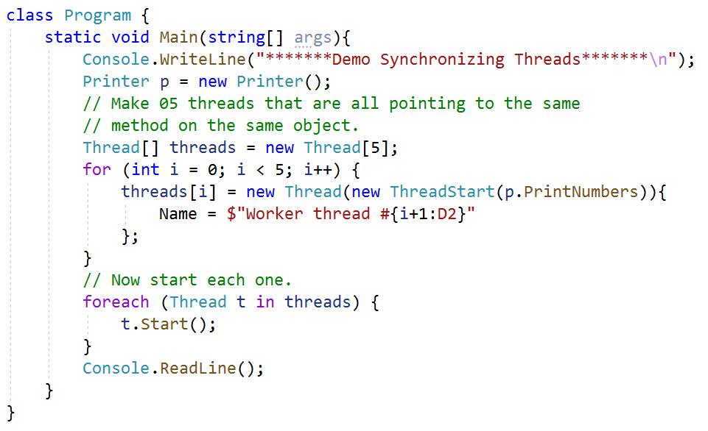
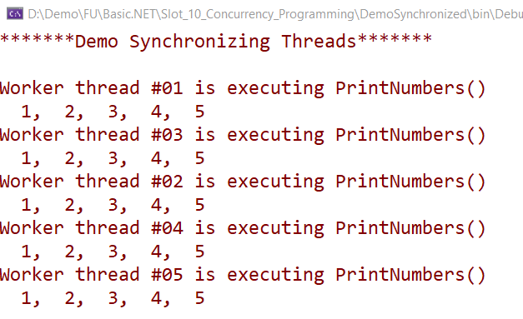
The Issue of Concurrency: Race Conditions

Slide 29
Working with the Timer Callbacks
Many applications have the need to call a specific method during regular intervals of time:
Display the current time on a status bar via a given helper function.
Perform noncritical background tasks such as checking for new e-mail messages
Use the System.Threading.Timer type in conjunction with a related delegate named TimerCallback

Slide 30
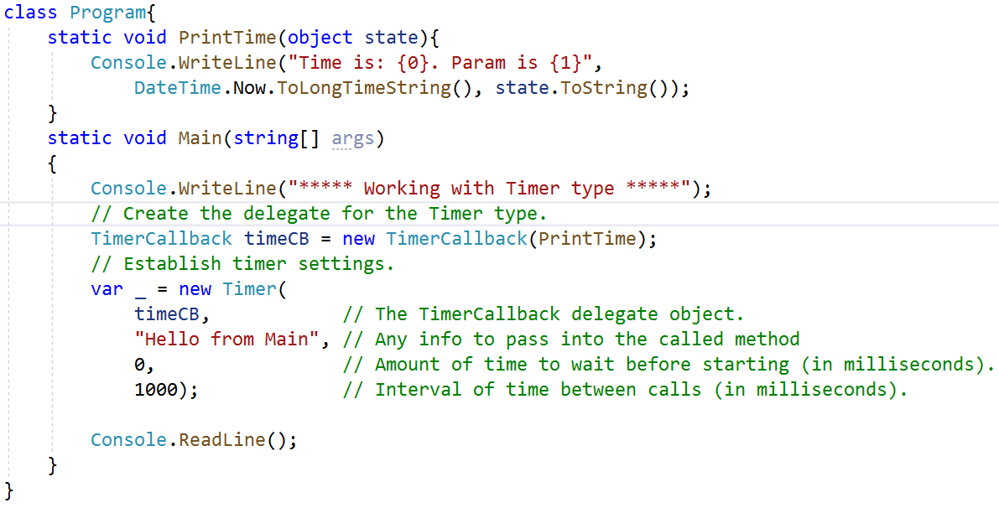
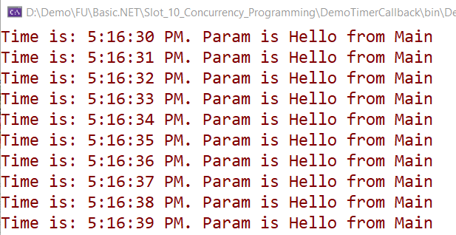
Working with the TimerCallback

Slide 31
Working with the ThreadPool
A thread pool is a pool of worker threads that have already been created and are available for apps to use them as needed. Once thread pool threads finish executing their tasks, they go back to the pool
The thread pool manages threads efficiently by minimizing the number of threads that must be created, started, and stopped
By using the thread pool, we can focus on our business problem rather than the application’s threading infrastructure
The ThreadPool class has several static methods including the QueueUserWorkItem that is responsible for calling a thread pool worker thread when it is available. If no worker thread is available in the thread pool, it waits until the thread becomes available

Slide 32
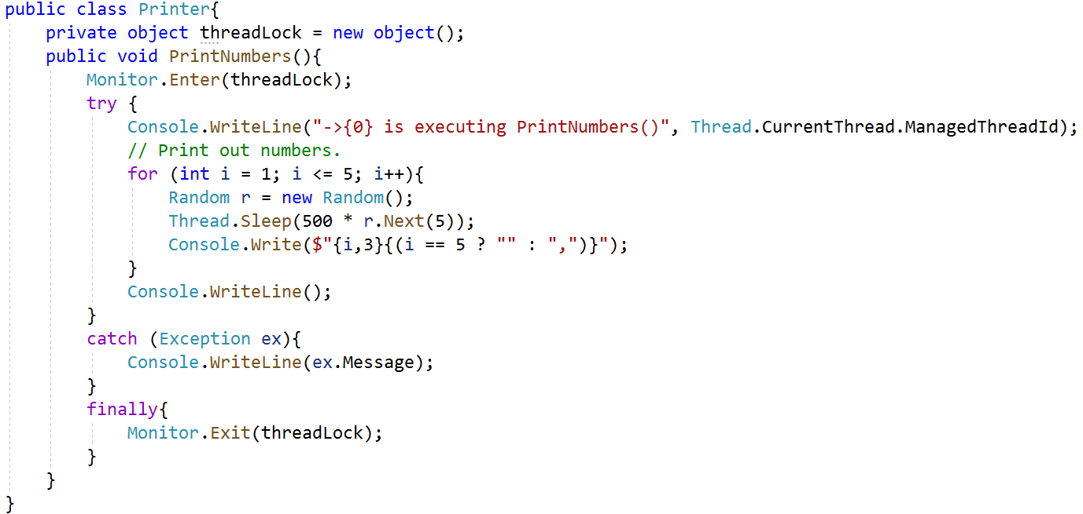
Working with the ThreadPool

Slide 33
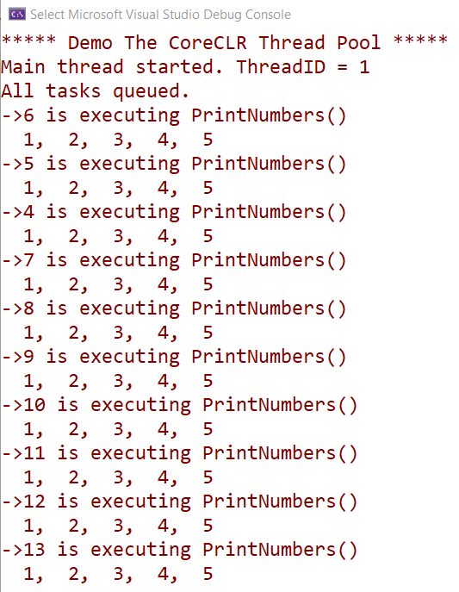
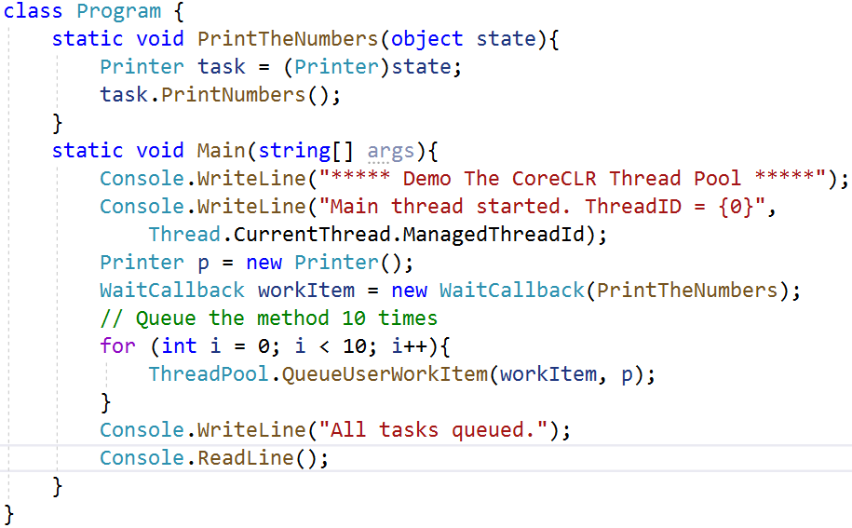
Working with the ThreadPool

Slide 34
Summary
Concepts were introduced:
Overview Concurrency Programming
Overview about MultiThreading
Explain about Synchronization: lock and Monitor
Explain and Demo about The Issue of Concurrency: Race Conditions
Explain about ThreadPool and TimerCallback
Demo MultiThreading application with C#
Demo Synchronization in MultiThreading application
Demo ThreadPool and TimerCallback

